Slide 1
A survey about methods dedicated to epistasis detection
4/7/2020
Niel et Al, 2015

Slide 2
Objective and main points
Gave an overview of existing methods about epistasis detection
Divided into Exhaustive and non exhaustive
Used to overcome limitations of Gwas (single-locus analysis, SNP tested one by one for association with the disease)
Complex illness are associated with gene interactions

Slide 3
Multi Locus Interactions studies
Divided into three main sections:
First section exhaustive search problem: unfeasible for large dataset
Second section: methods to reduce dataset size
Third section: Non exhaustive search, like ML techniques

Slide 4
A focus on epistasis: two main definitions
Biological Epistasis:
It only involve allele effect at one locus concealed by the effect of another allele at a second locus.
More recently extended to the following broader definition
General: An epistasis effect exists when the effect of an allele at a genetic variant depends either on the presence or absence of another genetic variant

Slide 5
Statistical Epistasis (Fisher 1908)
Def: Departure from additive effects of genetic variants at different loci with regard to the phenotype
Useful in practice for detecting epistasis interactions with computational method
Rationale behind: Canalization.
Evolution has favored complex robust systems resistant to variations. Hence, there is redundancy in biological systems
A disease state is an accumulation of mutations that outstripped its robustness

Slide 6
Challenges in Epistasis detection
Three (Plus one) main challenges to tackle
1. Statistical challenges:
large p, small n problem. Balancing false positive rate and false negative rate (multiple tests problem)
SNPs with low MAF (minor allele frequency) → sparse data → Curse of dimensionality
2. Computational challenge:
Complexity is linear in #samples but exponential in interaction order
Two-way interactions correspond to quadratic complexity 1mln SNPs → 5*10¹¹ pairwise interactions for an exhaustive search

Slide 7
Challenges in Epistasis detection
3. Interpretation challenge:
Interpret statistical results biologically is not straightforward. Statistical interactions does not imply interaction at the biological level
4. Ground truth problem:
There is no ground truth for matching and comparing results, just some SNPs marked by field experts as interesting

Slide 8
Exhaustive search for epistasis
Strategies of detection that exhaustively test all combinations of variants
Circumvent the problem of local optima
Mostly limited at pairwise interactions due to a lack of scalability

Slide 9
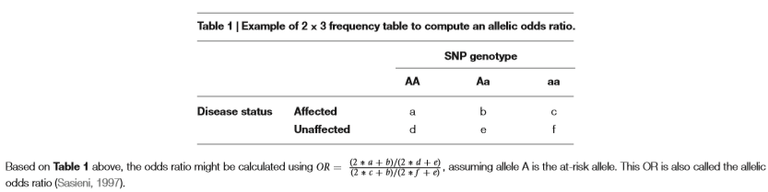
Parametric regression methods
Learn a fixed number of parameters from the data
Strong theoretical assumptions, perform poorly when violated
Logistic regression: compute Odds ratios of combination to estimate if a pair of SNPs affect disease status

Slide 10
Drawbacks and takeaways
Costly and non accurate procedure with large standard error due to the small sample sizes compared to genome-wide data size
Consequence: many false positive; Solution: Bonferroni → new problem: too conservative
Penalized regressions proposed (LASSO)
Restricted to two-way interactions
Prone to false positive
Too computational intense → need feature selection technique to filter data
Gou, J., Zhao, Y., Wei, Y., Wu, C., Zhang, R., Qiu, Y., et al. (2014). Stability SCAD: a powerful approach to detect interactions in large-scale

Slide 11
Likelihood based test and bit-wise representation
BOOST software runs these kind of analysis. [Wan, et al. (2010). BOOST: a fast approach to detecting gene-gene interactions in genome-wide case-control studies]
Main block: contingency tables
First step: transform genetic data in binary way to build contingency tables faster
Uses Fisher definition to detect interactions: test for a departure from the linear additive model.
That departure is expressed in terms of log-likelihood
To boost these calculations, authors use a non-iterative approximation of log-likelihood ratio (KSA) Matsuda, H. (2000). Physical nature of higher-order mutual information: intrinsic correlations and frustration.

Slide 12
Likelihood based test and bit-wise representation
Three main steps
Run an exhaustive search with approximately Log-likelihood ratio [lead to a high false positive rate]
On those reduced SNPs from 1. perform an exhaustive test with classical log-likelihood test
Significance of resultant is assessed with a Chi-square statistics

Slide 13
Takeaways and drawbacks
Step 3. can lead to accept SNPs pairs with no interaction but a strong marginal effect. → limited problems due to the two previous steps
Model way faster and with Power comparable to BEAM (Bayesian method treated later)
Relying on contingency table is sensible to low minor allele frequencies → lead to sparse contingency table → lead to #num of obs for cell hypothesis violated
High detection power but sensitive to type I errors [rejection of a true null hypothesis – false positive]

Slide 14
ROC curve analysis: GWIS
Model-free pairwise epistasis detection exhaustive search technique
Tests the difference in segregation power between a SNP pair and the corresponding SNPs taken individually thank to ROC curves
Take into account three ROC for each SNP pair, the two SNPs individually and the pair
If pair perform significantly better than other two [assessed by a hypothesis test difference in sensitivity and specificity that quantify the gain of a ROC over another one], then it is selected
Fast, can scale up
Limited to SNP pairs
Goudey, et al. (2013). GWIS–model-free, fast and exhaustive search for epistasis interactions in case-control GWAS

Slide 15
Multifactor dimensionality reduction (MDR): a full combinatorial approach
No parameters estimated
No hypothesis or assumptions on data
Could detect interactions even when marginal effects are non-existent
Can detect Higher order Interactions
It is a Reference method for comparison

Slide 16
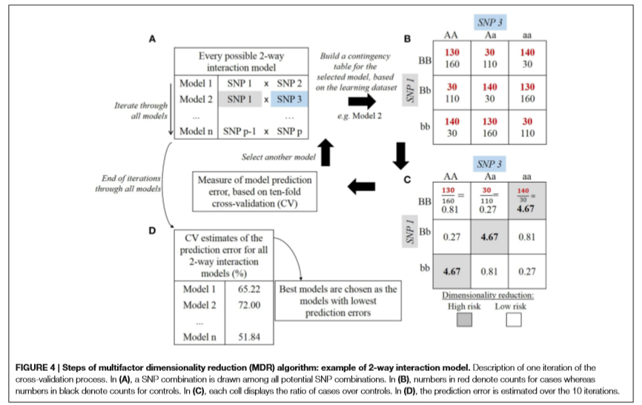

Slide 17
Drawbacks and Takeaways
Main feature: reduce data dimensionality
Flexible: can be easily combined with other techniques or enhanced
Brute force algorithm that lack scalability with huge number of SNPs
ALL aforementioned methods have a lack of scalability and/or they miss higher order interactions. One way to reduce this shortcoming is to preprocess data with the adequate filter, that has an important effect and have to be chosen carefully I.E. filter on marginal effect are counterproductive

Slide 18
Two stage approach –filter to obtain reduced space search
Objective: restrict the analysis to a small subset of candidate markers in order to make possible exhaustive search
Three main approaches:
Single SNPs-SNPs analysis to keep only SNPs with significant marginal effect
→ Lead to an obvious bias, detect only epistasis with strong marginal effects
Data mining techniques
Data Integration Techniques

Slide 19
Filtering based on data mining Techniques
ReliefF method (and its variants): learning informative features from the dataset without any a-priori knowledge
Computes a proximity measure between individuals
Steps: For a given individual, it marks its, usually 10, nearest neighborhood with the same phenotype [S] and the 10 NN with opposite phenotype [O]. a SNPs that has the same genetic variant in S and not in O it raise its importance
These steps repeated for a given number of individuals
Very scalable
Problem: Noisy markers may be attributed too much weight, hence inflating their importance
A lot of ReliefF algorithm variants created
Robnik-Šikonja, M., and Kononenko, I. (2003). Theoretical and empirical analysis of ReliefF and RReliefF

Slide 20
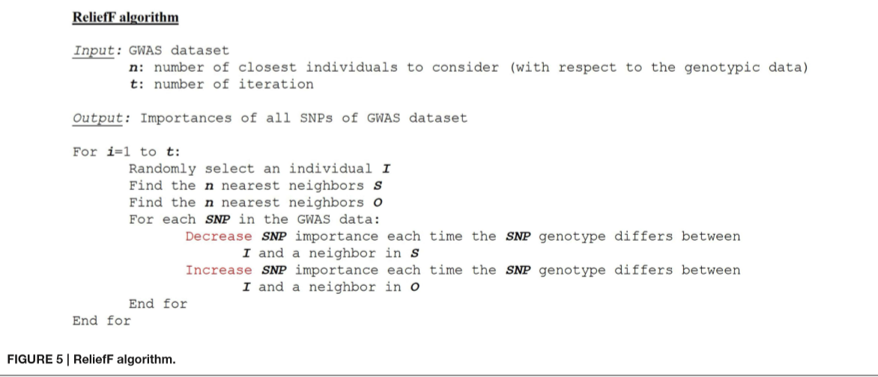
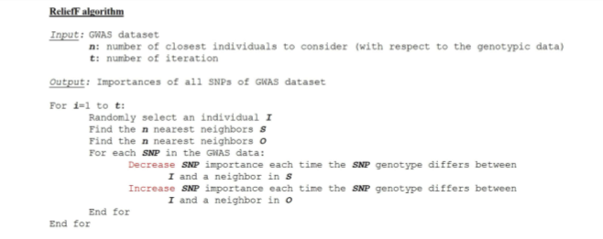

Slide 21
Some variants and their characteristic
RReliefF method: designed to study quantitative traits [kononenko 1994]
TuRF: To alleviate noisy marker problem, Propose to eliminate from SNPs set these SNPs with Low or no Importance [they rarely discriminate], then re-estimate importance of remaining SNPs. Result → detection power superior to ReliefF.
ECRF: attempt to solve noisy marker problem, it combines information theory and ReliefF. Outperform ReliefF
SURF methods: emancipate themselves from consider a fixed number of neighborhood [10 usually] and mark as neighbors all individual within a certain distance. Usually take into accounts 25-50% individuals as neighbors, Higher detection power, improved performance over ReliefF and Turf
SURF* also considers information on farthest individuals to build individual scores, improved performance over ReliefF and Turf

Slide 22
Filtering based on data Integration techniques
Main concept: use of knowledge of external databases in order to select SNP groups that are relevant to the phenotype of interest [Grady et al. 2011 ]
Avoids black box approach of data mining techniques that may hamper interpretability
Different strategies:
Narrow all SNPs down to a reduced list based on markers located in gene that encode for proteins involved in relevant interactions, then test are conducted on every interactions from a gene SNPs to all SNPs of another gene.
Failing to discover new biological models
Based on public protein-protein interactions [IntAct, BioGRID, STRING, ChEmbl]
2. As depicted above, but assigning a score for each SNP based on assessed relative importance of the proteins encoded by the genomic region

Slide 23
Filtering based on data Integration techniques
3. Pathways: [A biological pathway is a series of interactions among molecules in a cell that leads to a certain product or a change in a cell. Such a pathway can trigger the assembly of protein]
Based on evidence on public databases like KEGG pathway, reactome or Biocarta
For a pathway of interest, look at involved genes and map SNPs to relevant genes
Similar to previous protein-based approaches
More bias: some pathway are more studied than others → Genes involved will as consequence gain more weight.
4. Comprehensive knowledge approach
More goal: it exploit pathways , proteins interactions, gene expression, ..
Not currently possible to evaluate these results because implement a simulation to evaluate is not trivial nor feasible.

Slide 24
Filtering based on data Integration techniques
Software worth mentioning: BIOFILTER
Main concept: the more two genes are involved in a relationship the more likely are to share an important biological link
It gathers information from 13 databases containing experimental evidence of interactions, pathway or ontological similarity relationship
Model interactions irrespective of the marginal effects
Create polygenic models, thanks to a gene-disease and gene-gene connection knowledge
Not all combination are examined

Slide 25
Conclusion and takeaways
Exploiting external information sources like pathways or protein-protein interactions networks is controversial
Online databases are incomplete
Our understanding of pathway are incomplete
Result: flawed analysis
Solution: combine both biased approach [data-integration techniques] and computational approach driven by GWAS analysis
Moore, J. H., Amos, R., Kiralis, J., and Andrews, P. C. (2015). Heuristic identiﬁcation of biological architectures for simulating complex hierarchical genetic interactions

Slide 26
Non-exhaustive searches enhanced by Artificial intelligence
Alternative to parametrical statistical model
Main categories:
Machine learning methods
Build non-parametric models to compile information
Random forest, Bayesian network-based strategies
Combinatorial optimization
Consider a search space of solutions and browse through them to find the more relevant combinations
Ant-colony optimization computational evolution system
Precautions to be taken to prevent overfitting
Non-affordable if complexity of genetic mechanism too high respect to sample size small

Slide 27
Non-exhaustive searches enhanced by Artificial intelligence
These models utilizes Heuristic, that test for associations of variants ALLOWING interactions, they do not test interactions themselves
They also include SNPs with marginal effects

Slide 28
Random forest and their variants
Each node represent a SNPs.
It can handle SNPs that are associated in a non-linear way, dealing with interactions encoded in a hierarchical fashion between layers of the tree.
Good strategy for detecting univariate (non epistasis) SNPs in large-scale association studies
Variable importance represents weight approximating the causal effect of a predictor variable→ in these studies conditional variable importance is the preferred method.
Algorithm readjusted for epistasis detection: include multiple SNPs at each node during tree building [Botta, V., Louppe, G., Geurts, P., and Wehenkel, L. (2014). Exploiting SNP Correlations within Random Forest for genome-wide association studies.]
Aims to detect SNPs combination with low marginal effects
Cannot make a distinction between a) interacting SNPs and b) several independent SNPs definitively
Result: lack clear interpretation

Slide 29
Random forest and their variants
GWGGI [Wei, C., and Lu, Q. (2014). GWGGI: software for genome-wide gene-gene interaction analysis.]
Differences with previous method:
Tree-growing algorithm more computationally efficient: standard variable selection is replaced by a forward algorithm
→Principle of a forward algorithm: take into account previously selected variables
→ Novel variable is the one that added to the existing set will allow for most accurate prediction

Slide 30



Random forest and their variants
Relies on likelihood ratios to and the Mann-Whitney statistics to assess the predictors’ importance
Facilitate statistical significance analysis
Procedure: for each single tree, for each individual a likelihood ratio, Probability of its genotype [SNP] given the its case/control status, is calculated.
All these probability are averaged, for each individual, over all the trees., for the selected SNPS
Then a U-statistic is calculated and tested versus H0 that there is no association between the selected SNP and the phenotype

Slide 31
Bayesian network
Provide a compact representation for dependencies between variables
Two components:
a direct acyclic graph (DAG), where variables are nodes and dependencies are edge
A probabilistic component that associates a probability distribution with each node
Encodes Markov property: each variable is independent of its non-descendant, given its parents in the DAG
Basic unit, variables, are SNPs and phenotipically values
Structure learning is NP-hard → techniques to reduce burden

Slide 32
Bayesian network
BEAM [Zhang, Y., and Liu, J. S. (2007). Bayesian inference of epistasis interactions in case-control studies.]
Bayesian reference for performance comparisons
Rely on a Markov Chain Monte Carlo that test iteratively each marker, conditional on the status of other markers
For each marker output posterior probability of association with disease
Markers divided in three groups 0 -> no contribution 1 -> independent contribution
2 -> epistasis model
B-Statistic used for further filter SNPs:[introduced to get rid of expensive permutation test, IT IS AN ALTERNATIVE TO CHI-SQUARE TESTS
Does not scale: Mcmc ITERATIONS make this method unfeasible when #SNPS> 500 000

Slide 33
Bayesian network
2. EpiBN [Han, B., Chen, X. W., Talebizadeh, Z., and Xu, H. (2012). Genetic studies of complex human diseases: characterizing SNP-disease associations using Bayesian networks. .]
The authors Consider SNPs causal with respect to the phenotype
Two layer : 1) Phenotype AS unique node; connected with 2)parent nodes of phenotype in second layer , the SNPs associated with the phenotype
Edges between nodes are allowed → detect interactions of variants of SNPs
For learning the network, they use a Branch-and-Bound iterative procedure
Each interaction adds, deletes or reverses an edge
Score function to evaluate to find the best network structure evolution
Based on fit of data & a penalization for complexity
EpiBN reach higher detection power than BEAM

Slide 34
Bayesian network
3. Markov-blanket based methods [Alekseyenko, A. V., Lytkin, N. I., Ai, J., Ding, B., Padyukov, L., Aliferis, C. F., et al. (2011). Causal graph-based analysis of genome-wide association.]
Allows discovery of SNPs in the local pathway of the phenotype [local causal SNPs]
Avoid time-consuming learning processes
Principle: find a minimal set of SNPS that completely shield the disease status from all other variables. [Markov Blanket] → Result: a local Bayesian Network fraction that borders the phenotype nod in the graph
Each SNPS will be statistically independent of the case.control when conditioned on the Markov Blanket
Low number of False positive; strategy very compact; very scalable
Stages:
Forward pass → Add new relevant variables, finding SNPs most associated with the phenotype given the current Markov blanket. [Repeated until Markov Blanket do not change]
Backward Phase: Check every SNPs in the Markov Blanket and delete those who are indipendent to the phenotype, with respect on the remaining Markov Blanket

Slide 35
3. Markov-blanket based methods
Three implementations
DASSO-MB → The authors Consider SNPs causal with respect to the phenotype [as EpiBN], so they consider only parent nodes
TIE*
IMBED
Takeaways:
All these approaches more sample-efficient than BEAM [same results with less samples]
There is a Bias: the first SNPs is detected with a univariate test → detection of epistasis related to markers with low marginal effects

Slide 36
Ant colony optimization
Main concept: if an ant finds a shorter path, it will produce ad increase pheromone level along the path → other ants will more likely follow the path → increasing pheromone concentration →positive feedback
Search of multiple group of SNPs in parallel
Iterative procedure; each ants represent a SNP set with potential epistasis effects
Communication between Ants is mimicked by a common PDF probability shared by all ants (Probability depends on pheromone levels and external knowledge domain-related)

Slide 37
Ant colony optimization
AntEpiSeeker
Step 1:
Multiple SNPs picked up based on PDF, to build each ant
Chi-square test used to measure association ants-phenotype
Results update next iteration
Step 2: Once a set of suspected sets of SNPs are assembled
Exhaustive search of epistasis within each built ants [final ants]
Exhaustive search also on the set of SNPs with highest PDF
More recent algorithm: MACOED

Slide 38
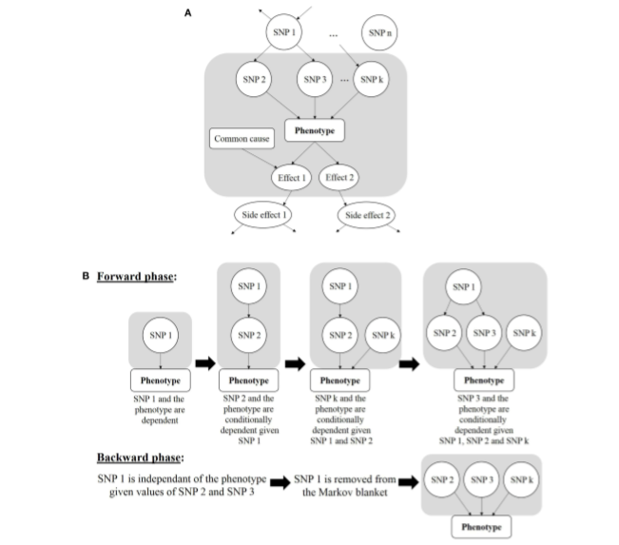
Ant colony optimization
Takeaways and drawbacks:
Positive feedback effect very interesting
Many parameters require fine tuning [#iterations, order of interaction, #SNPs in each ants,..] and have to be estimate at priori

Slide 39
Computational evolution system
Main concept: Based on Darwinian evolution and selection
Goal: grow a computer program from several basic building block
Building Block: BASIC FUNCTION involving SNPS [operator add, delete and copy that aggregates SNPs]
Resulting combinations of building blocks are called solution → aims to predict case/control
Pyramidal architecture:
Lowest level -> two-dimensional grid of solutions, each of it involving a list of building blocks
2) -> grid of solution operators influencing lower level [each cell is an operation add/delete/copy that has a certain probability of being extracted]
3) -> INTRODUCE CHANGE IN EXECUTION PROBABILITIES OF lower level
4) ->Control the variation rate in lower level (add uncertainty)

Slide 40
Computational evolution system
Generation: step in which solutions are modified
In each generation a operator is drawn randomly from 2) level based on 3) level probability
Operator applied to all solutions
Accuracy: each solution is applied to case and control→ distinct score distribution → threshold = average of the two median
Individuals predicted case or control based on threshold [Error = %misclassifieds]
Solution selected: on a neighborhood of 8 solution, maximal accuracy is moved to the central place of these 8

Slide 41
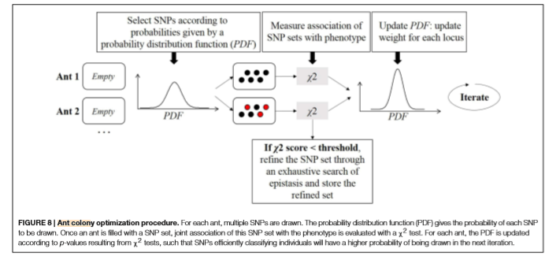
drawbacks and takeaways
Allows modeling of complex interactions with few hypothesis
Capability to use expert knowledge
Well suited for parallalization
Computationally very complex, need prefilter as in stage 2 to run on gwas-like datasets

Slide 42
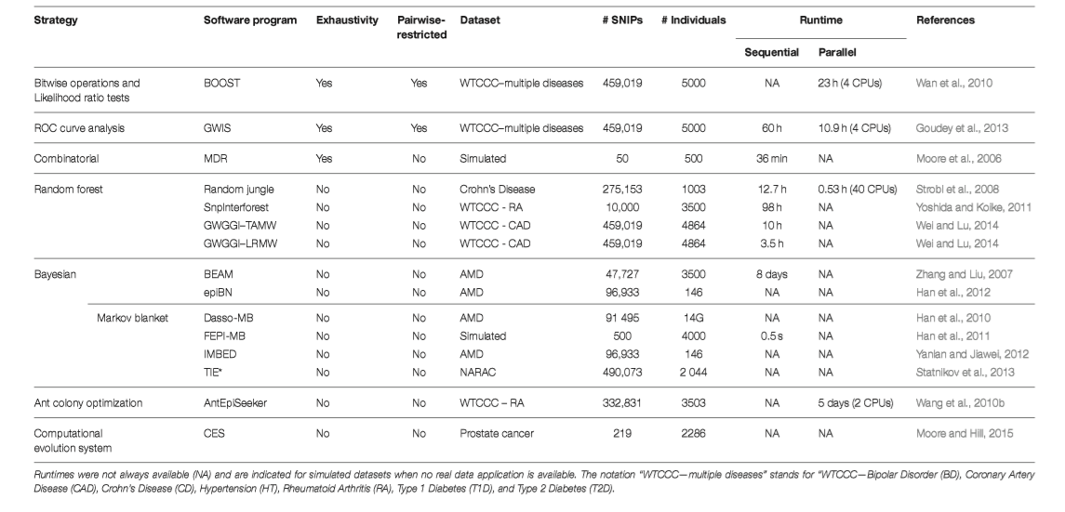
drawbacks and takeaways
Allows modeling of complex interactions with few hypothesys
Capability to use expert knowledge
Well suited or parallelization
Computationally very complex, need prefilter as in stage 2 to run on gwas-like datasets

Slide 43
Final discussion
Exhaustive search for higher order interactions is not feasible
The table above depict the largest dataset that each method has used.
Genetic variants of complex traits is weakly explained by detected interactions → due to low detected power
For improving precision → improve ratio #samples / #SNPs
Increasing samples size Improve power of epistasis detection
Reducing #SNPs improve statistical power
Data-integration techniques are biased and must be combined with unbiased approaches
Confusing boundary between epistasis and linkage disequilibrium [association between 2 SNPs without regard to the phenotyupe]
More problematic in case-only datasets
Simulation model developed to assess efficiency
Still too simple and with only pairwise interactions
For evaluating results p-values are used, but they are not a statement about associations strength
Need for scalable and powerful strategies is clearly unmet

Slide 44
Conclusion
No strategy stands out
Balancing between time-efficiency and detection power
Techniques to reduce running times
Parallelization
Approaches based on computational evolution
Gpu-based running

